Slide 1
Topic: Pronumerals EQ: How do we use pronumerals?
Year 11 Essentials

Slide 2
Things Required For This Lesson
Interactive Notebook
Textbook: Interleaved Maths Essential Connections
Ruler, Red Pen, Pencil, Pens, Scientific Calculator
Growth mindset

Slide 3

24
7
30
Topic: Pronumerals
EQ: How do we use pronumerals?
WICOR
This Photo by Unknown Author is licensed under CC BY-SA

Slide 4
First 5
Simplify 30cm : 2m
Simplify 4y+5y+7x-4x
A car is driving at 80km/h, how long would it take the car to travel 200km?
IF a=5 and b=6, what is 4a+b?
5. What has words, but never speaks?
Answers
3:20
9y+3x
2 and 30 mins
26
A Book

Slide 5
Post-it note game
Step 1: put a “+” sign on 2 yellow post-it notes and on 4 green post-it notes
Step 2: Put a “-” on 3 green post-it notes and on 4 yellow post-it notes.
Step 3: if you can pair a + with a – from the same colour post it note, they cancel each other out. Find the pairs and cancel them out.
Step 4: The winner is the first person to work out how much of each post-it note is left.
Step 5: You should have 2 – yellow and 1 + green. You can write this as -2y+g
Notes:
You will need 2 different colour post-it notes pads.

Slide 6
24
7
30
Topic: Pronumerals
EQ: How do we use pronumerals?
What is a pronumeral?
A pronumeral is a letter that is used to represent a number
How do we simply expressions?
You can simplify expressions by collect like terms.
Like terms are terms that have the exact same letters in them.
(the post it game is a strategy to help with simplifying)
WICOR

Slide 7

Practice
Simply the following. You can use post-it notes to assist you.
-3y +2g -2y-1g
+2y -3 +2y -3g
-4g +2y -4y+2g
-3w +2y -2g -4y +1w+5g
+3y-2x-y+5x
-2y-2x+4y+3y

Slide 8
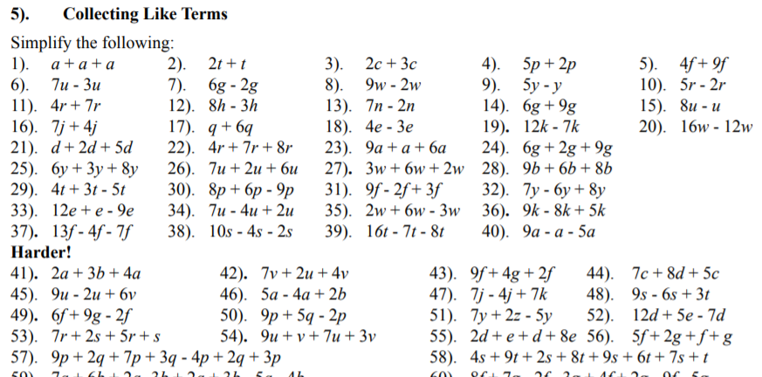

Slide 9

Thank you
Keep up the good work!
Quote of the day –
“Just do it”- NIKE

